Slide 1
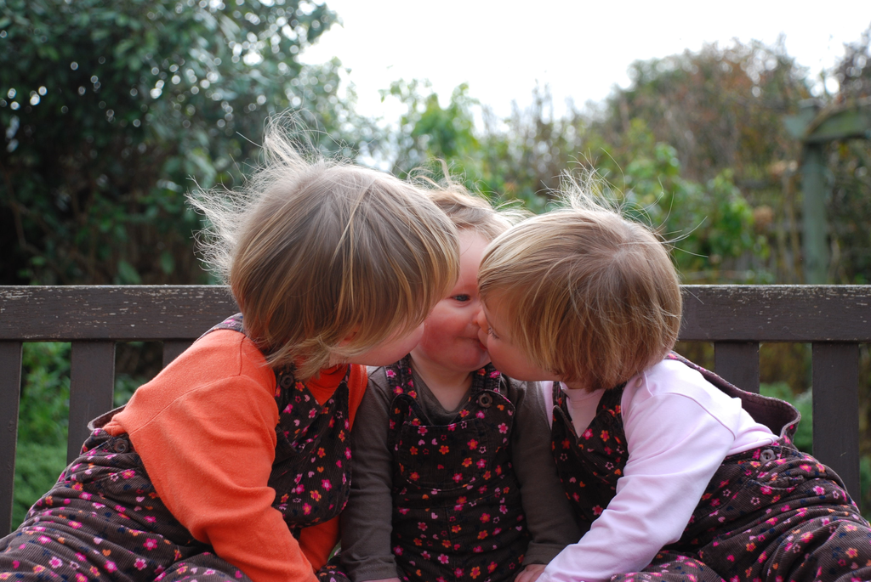

Pluralism about Joint Action

Slide 2
the ‘potential role of shared emotions in [...] joint action (e.g. initiating, motivating, structuring, facilitating).’
the ‘potential role of shared emotions in [...] joint action’

Slide 3
the ‘potential role of shared emotions in [...] joint action (e.g. initiating, motivating, structuring, facilitating).’
What motivates people to engage in joint action?
What are the perceptual, cognitive, and motor processes that enable effective joint action?
the ‘potential role of shared emotions in [...] joint action’

Slide 4
the ‘potential role of shared emotions in [...] joint action (e.g. initiating, motivating, structuring, facilitating).’
What motivates people to engage in joint action?
What are the perceptual, cognitive, and motor processes that enable effective joint action?
What distinguishes joint from individual actions?
the ‘potential role of shared emotions in [...] joint action’

Slide 5
The Obstacle

Slide 6
painting the house together
lifting a heavy sofa together
preparing a hollandaise sauce together
going to Chicago together
walking together

Slide 7
painting the house together
lifting a heavy sofa together
preparing a hollandaise sauce together
going to Chicago together
walking together

Slide 8
painting the house together
lifting a heavy sofa together
preparing a hollandaise sauce together
going to Chicago together
walking together

Slide 9
painting the house together
lifting a heavy sofa together
preparing a hollandaise sauce together
going to Chicago together
walking together
Shared emotion is not a feature of every joint action.
There are characteristic features common to all joint actions (e.g. shared intention).
Only such features are relevant to answering constitutive questions about what joint action is.

Slide 10
painting the house together
lifting a heavy sofa together
preparing a hollandaise sauce together
going to Chicago together
walking together
Shared emotion is not a feature of every joint action.
There are characteristic features common to all joint actions (e.g. shared intention).
Only such features are relevant to answering constitutive questions about what joint action is.

Slide 11
painting the house together
lifting a heavy sofa together
preparing a hollandaise sauce together
going to Chicago together
walking together
Shared emotion is not a feature of every joint action.
There are characteristic features common to all joint actions (e.g. shared intention).
Only such features are relevant to answering constitutive questions about what joint action is.

Slide 12
Shared Intention

Slide 13

‘I take a collective action to involve a collective intention.’
‘the key property of joint action lies in its internal component [...] in the participants’ having a “collective” or “shared” intention.’
(Facundo Alonso, 2009, pp. 444-5)

Slide 15
awareness of joint-ness
at least one of the agents knows that they are not acting individually; she or they have ‘a conception of themselves as contributors to a collective end.’
awareness of others’ agency
at least one of the agents is aware of one or more of the others as an intentional agent.
awareness of others’ states or commitments
at least one of the agents who are F-ing is aware of, or has individuating beliefs about, some of the others’ intentions, beliefs or commitments concerning F.

Slide 16
awareness of joint-ness
at least one of the agents knows that they are not acting individually; she or they have ‘a conception of themselves as contributors to a collective end.’
awareness of others’ agency
at least one of the agents is aware of one or more of the others as an intentional agent.
awareness of others’ states or commitments
at least one of the agents who are F-ing is aware of, or has individuating beliefs about, some of the others’ intentions, beliefs or commitments concerning F.

Slide 17
awareness of joint-ness
at least one of the agents knows that they are not acting individually; she or they have ‘a conception of themselves as contributors to a collective end.’
awareness of others’ agency
at least one of the agents is aware of one or more of the others as an intentional agent.
awareness of others’ states or commitments
at least one of the agents who are F-ing is aware of, or has individuating beliefs about, some of the others’ intentions, beliefs or commitments concerning F.

Slide 18
awareness of joint-ness
at least one of the agents knows that they are not acting individually; she or they have ‘a conception of themselves as contributors to a collective end.’
awareness of others’ agency
at least one of the agents is aware of one or more of the others as an intentional agent.
awareness of others’ states or commitments
at least one of the agents who are F-ing is aware of, or has individuating beliefs about, some of the others’ intentions, beliefs or commitments concerning F.

Slide 19
awareness of joint-ness
at least one of the agents knows that they are not acting individually; she or they have ‘a conception of themselves as contributors to a collective end.’
awareness of others’ agency
at least one of the agents is aware of one or more of the others as an intentional agent.
awareness of others’ states or commitments
at least one of the agents who are F-ing is aware of, or has individuating beliefs about, some of the others’ intentions, beliefs or commitments concerning F.

Slide 20
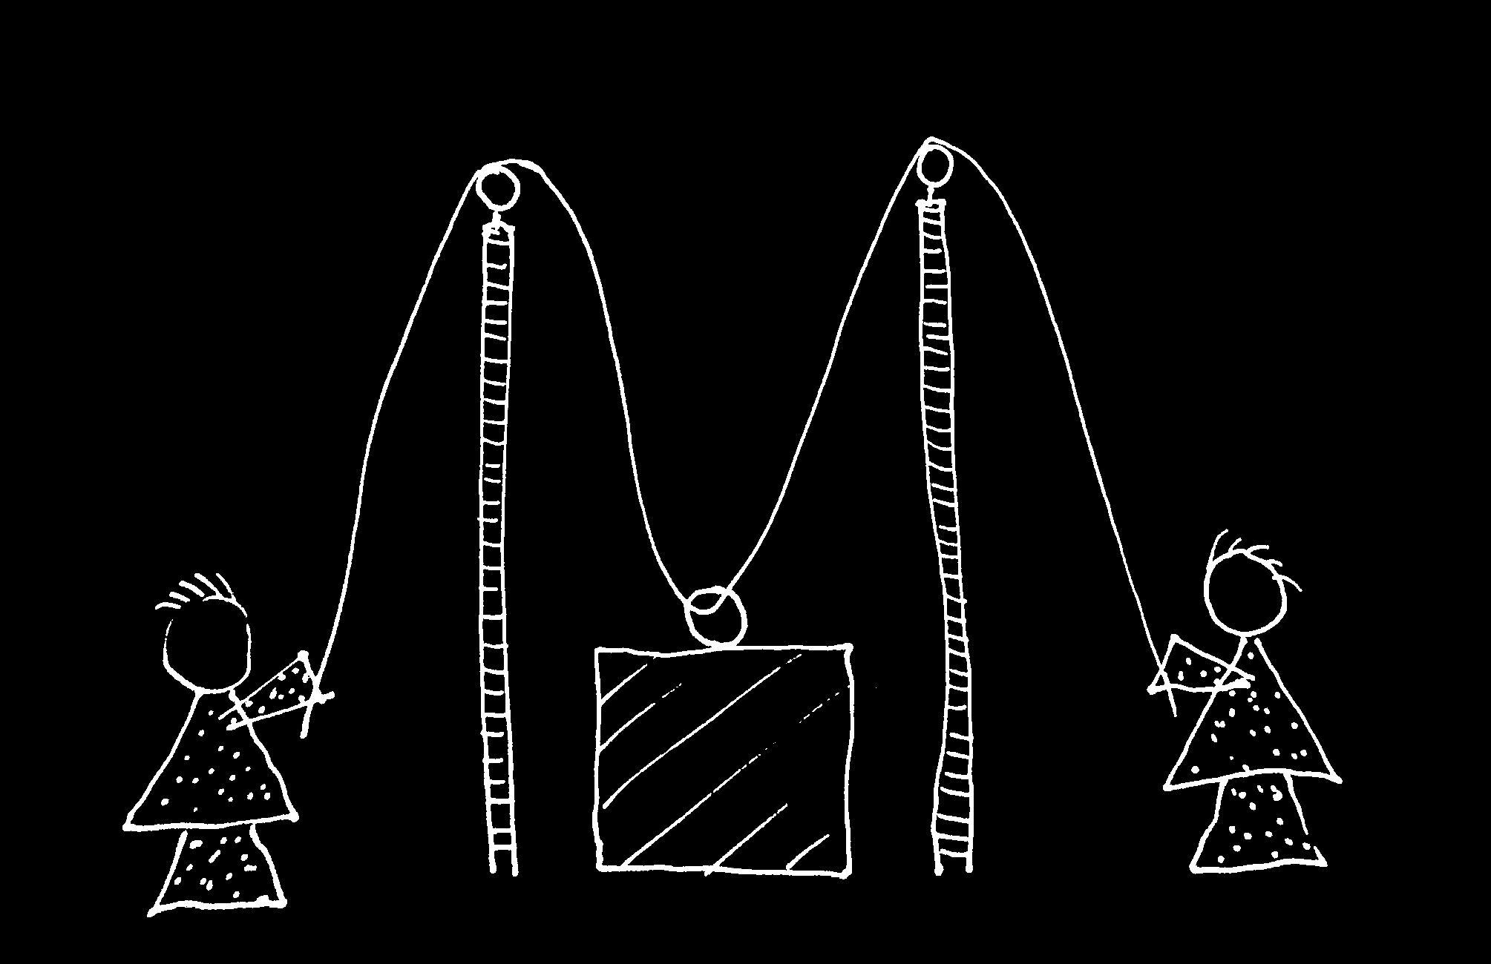
cf. Vesper et al (forthcoming)

Slide 21


Slide 22
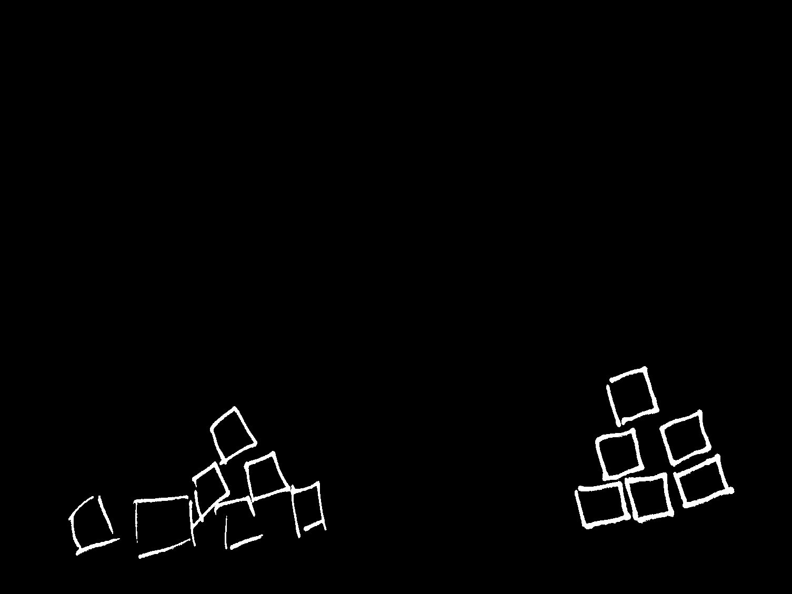

Slide 24
But Are They Joint Actions?

Slide 25
an imaginary super-agent

Slide 26
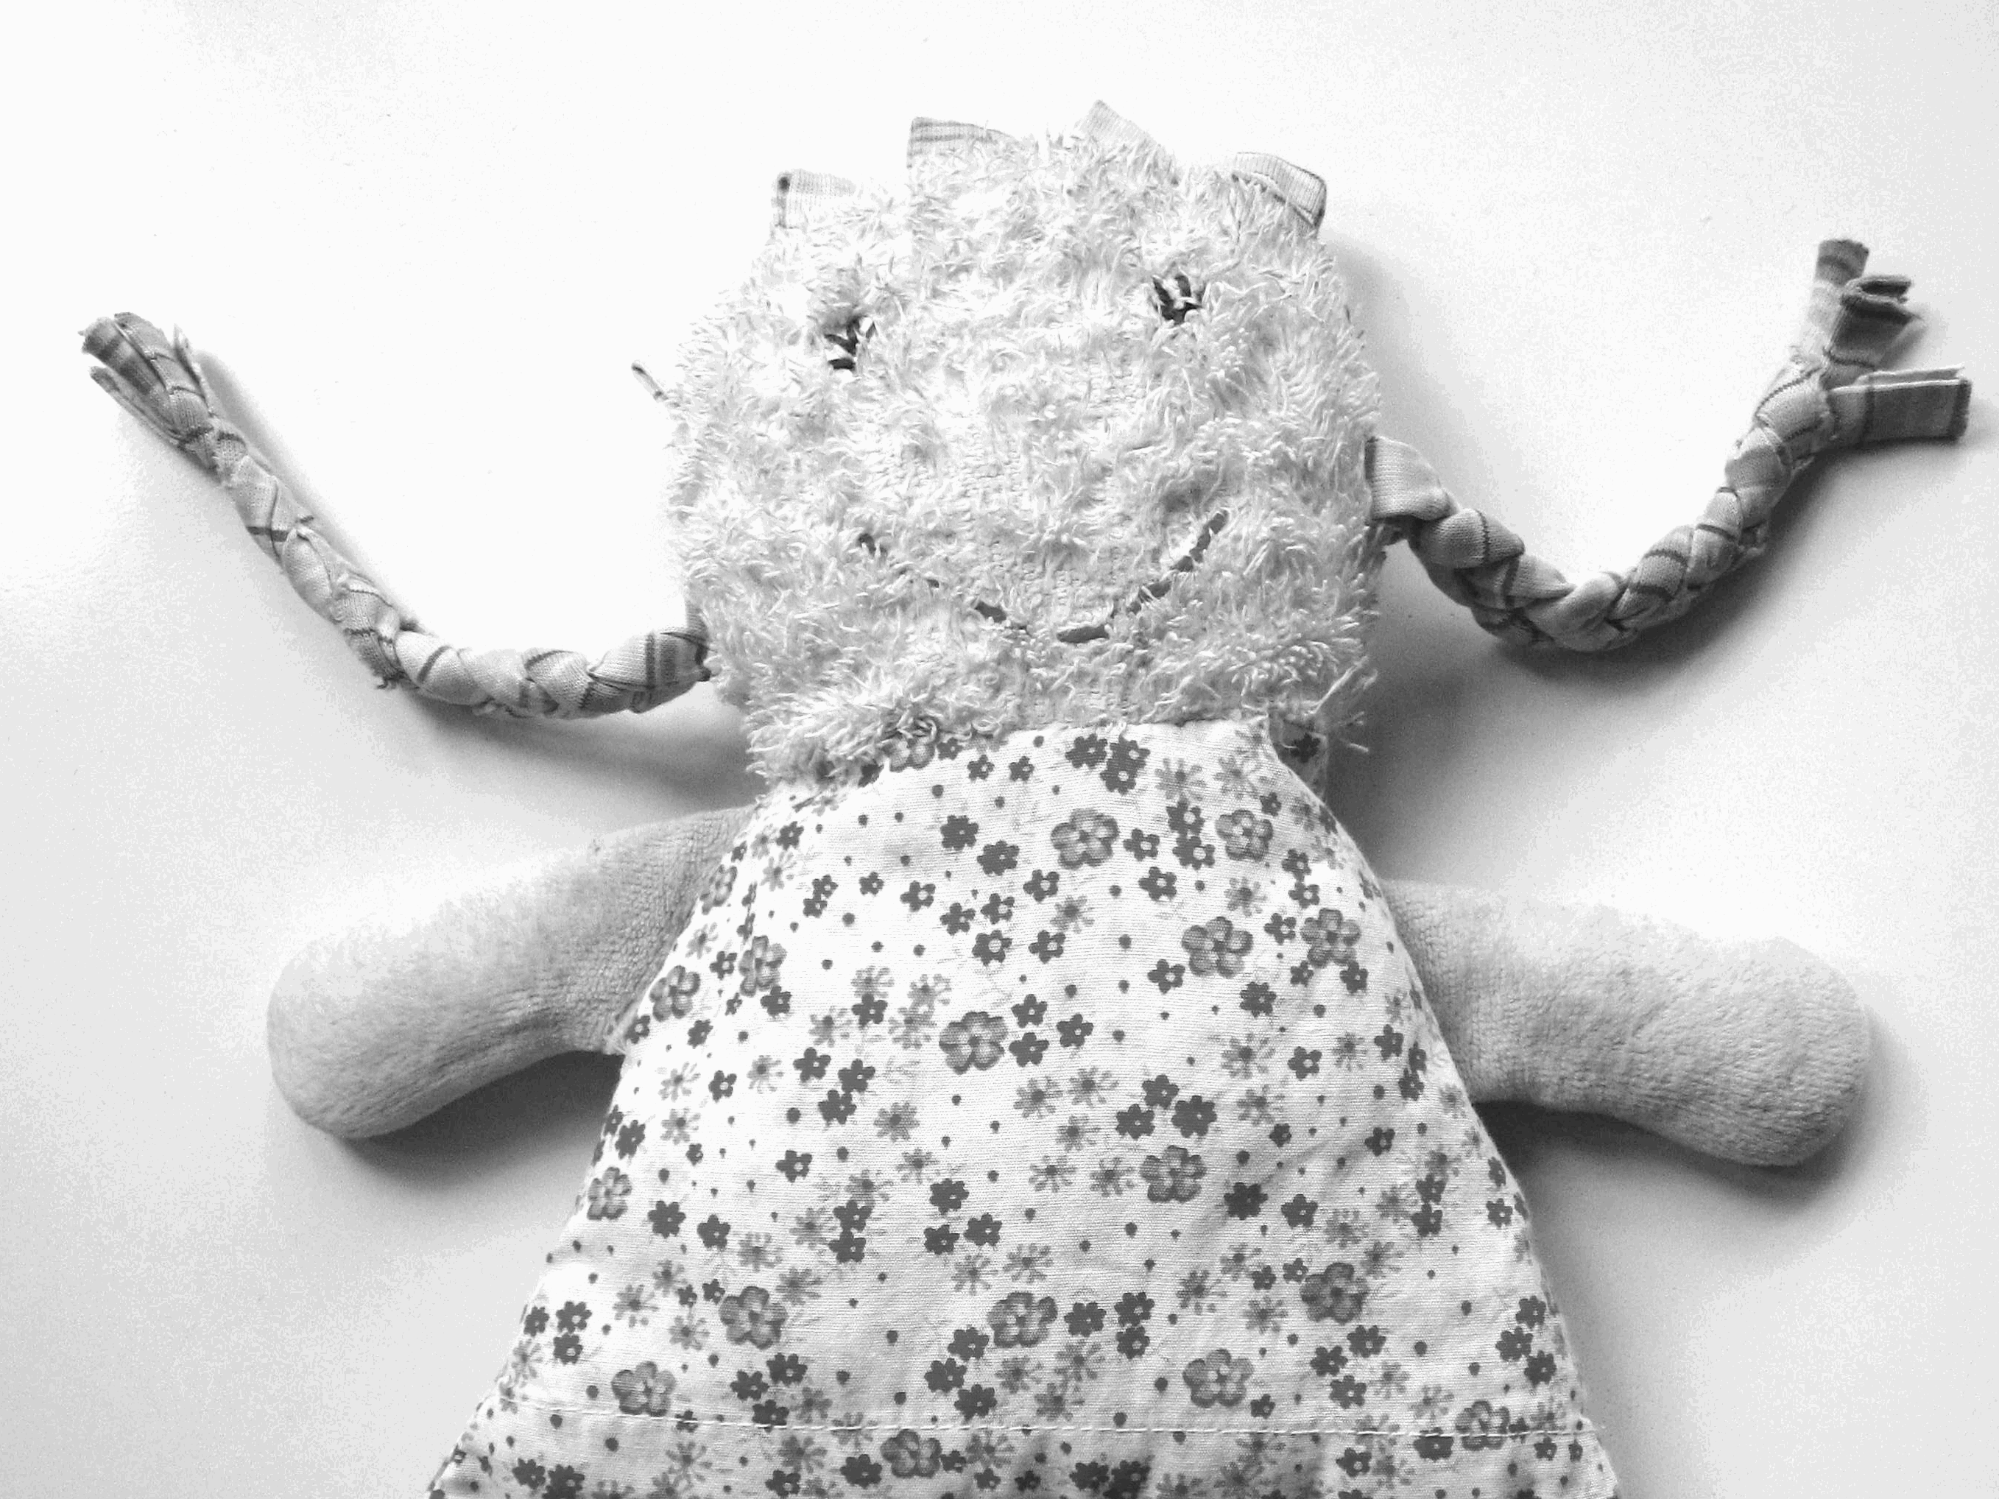

Slide 27
awareness of joint-ness
at least one of the agents knows that they are not acting individually; she or they have ‘a conception of themselves as contributors to a collective end.’
awareness of others’ agency
at least one of the agents is aware of one or more of the others as an intentional agent.
awareness of others’ states or commitments
at least one of the agents who are F-ing is aware of, or has individuating beliefs about, some of the others’ intentions, beliefs or commitments concerning F.

Slide 28
There are no characteristic features common to all joint actions

Slide 29
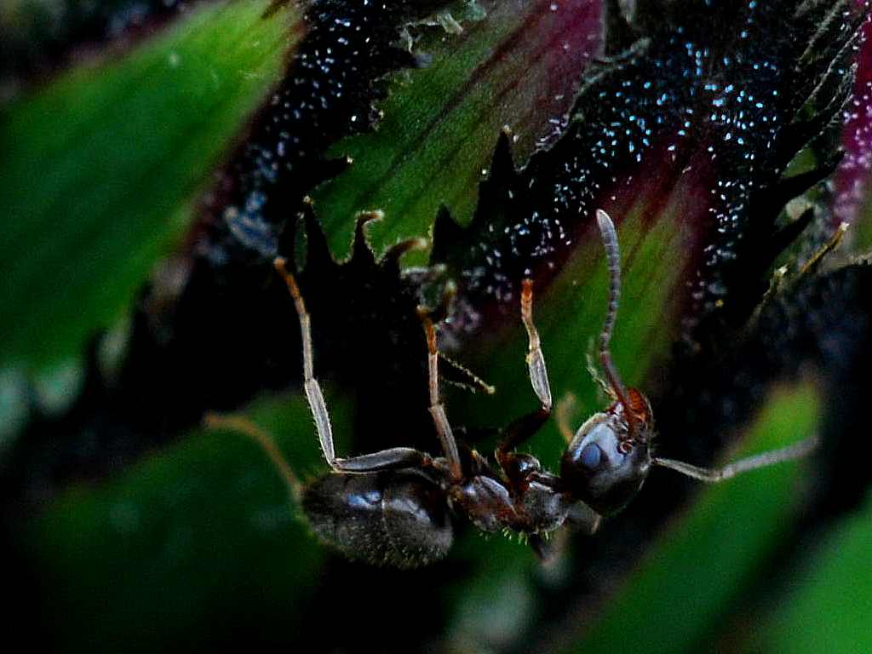

Slide 30
sting
sting
sting
sting
sting
death of fly
sting
sting
sting

Slide 31
sting
sting
Plural activity
- multiple agents’ activities are individually organised around a single outcome
- this outcome occurs as a common effect of, or is constituted by, all their activities
sting
sting
sting
death of fly
sting
sting
sting

Slide 32
Plural activity
- multiple agents’ activities are individually organised around a single outcome
- this outcome occurs as a common effect of, or is constituted by, all their activities

Slide 33
Plural activity
- multiple agents’ activities are individually organised around a single outcome
- this outcome occurs as a common effect of, or is constituted by, all their activities
Almost sufficient conditions for joint action
- plural activity
- something coordinates the agents’ activities
- the coordination is, or would normally be, among the causes of the outcome

Slide 34

‘Ayesha and Beatrice between them lifted the block’

Slide 35
‘Ayesha and Beatrice between them lifted the block’
‘Left Leg and Right Leg between them supported the table’
‘Ayesha and Beatrice between them lifted the block intentionally’

Slide 36
‘Ayesha and Beatrice between them lifted the block’
‘Left Leg and Right Leg between them supported the table’
‘Ayesha and Beatrice between them lifted the block intentionally’

